Slide 1




Cultivating the Creative Commons
Professor Brian Fitzgerald
ARC Centre of Excellence for Creative Industries and Innovation
part of the Creative Commons international initiative
CRICOS No. 00213J

Slide 2

Access Drives Innovation
Access and Reuse Drives Creativity and Innovation
OCL – Open Content Licensing – signals the access and reuse rights in advance.
Across:
  Culture
  Government
  Education
  Research
‘It’s an open book’ by destinelee, CC BY-SA 2.0, http://flickr.com/photos/valeriebb/2045780152/
Australian OCL Case Studies:
http://wiki.creativecommons.org/casestudies
part of the Creative Commons international initiative
CRICOS No. 00213J
CRICOS No. 00213J

Slide 3




  “some rights reserved”
  “all rights reserved”
  “no rights reserved”
‘Free Content for a Free Society’ by Matthias Mehldau, CC BY 2.0, http://flickr.com/photos/wetterfrosch/130493803/
part of the Creative Commons international initiative
CRICOS No. 00213J

Slide 4
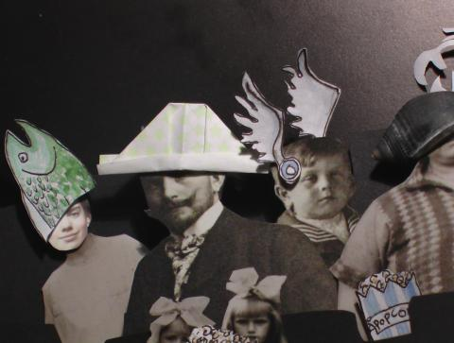
CULTURE
‘The future of public media’
ABC’s online experimental collaborative media publishing platform where contributors can share content, connect with people and grow ideas across the globe.
Pool publishes content based upon four fundamentals: honesty, fairness, independence, and respect (ABC Editorial Policies)
Public launch 21 July 2008
‘Creative Commons licences assisted us to facilitate community media co-creation and sharing.’ – John Jacobs, ABC Pool developer
‘WAT Advert’ by Harriet Macdonald, http://www.pool.org.au/image/harriet_macdonald/wat_advert
part of the Creative Commons international initiative
CRICOS No. 00213J

Slide 5
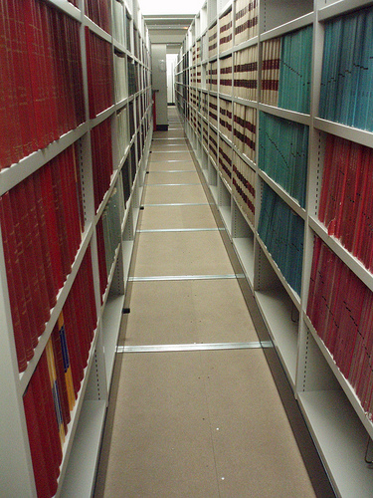
GOVERNMENT
Queensland Spatial Information Council (QISC) Whole-of-Government Information Licensing Project (GILF)
Commissioned in 2005 to review how licensing could be used to enable better access to government assets
So far, study has found that:
  there are significant problems with the Queensland Government’s current approach to information licensing, particularly in relation to the lack of adequate or uniform practices; and
  approximately 85 percent of government material could and indeed should be made available under a CC licence.
Now moving into 3rd stage – pilot implementation for geospatial data
“Our Government Information Licensing Framework (GILF) project based on this work is likely to be used as a template for governments across Australia and across the world.”
Dr Peter Crossman Queensland Government
‘Rayonnages en magasin’ by marlèned, CC BY-NC-ND 2.0, http://flickr.com/photos/marlened/2497221357/
part of the Creative Commons international initiative
CRICOS No. 00213J

Slide 6
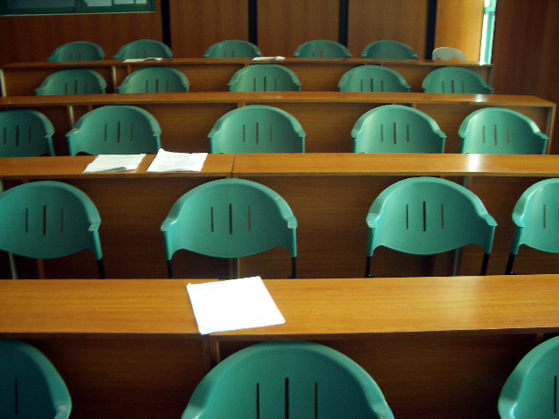
Education
EDUCATION
“CC licensing has revolutionised the way we think about copyright management in schools … The CCi group, as the leaders of CC in Australia, has provided an invaluable resource to the education community which will have an enormous impact on the creativity and productivity of young Australians.”
Delia Browne, National Copyright Director, MCEETYA
‘Classroom Chairs 2’ by Eric James Sarmiento, CC BY 2.0, http://flickr.com/photos/ijames/112866961/
part of the Creative Commons international initiative
CRICOS No. 00213J

Slide 7
Education
RESEARCH
part of the Creative Commons international initiative
CRICOS No. 00213J

